Slide 1
LessonAble
Introduction to a brand new way of using the deep fake to create video lessons based on just text.
Ciro Sannino, 12/07/2021

Slide 2

It has been noted that…
the amount of time required to record a video lesson following a well-defined text is really TOO HIGH.

Slide 3
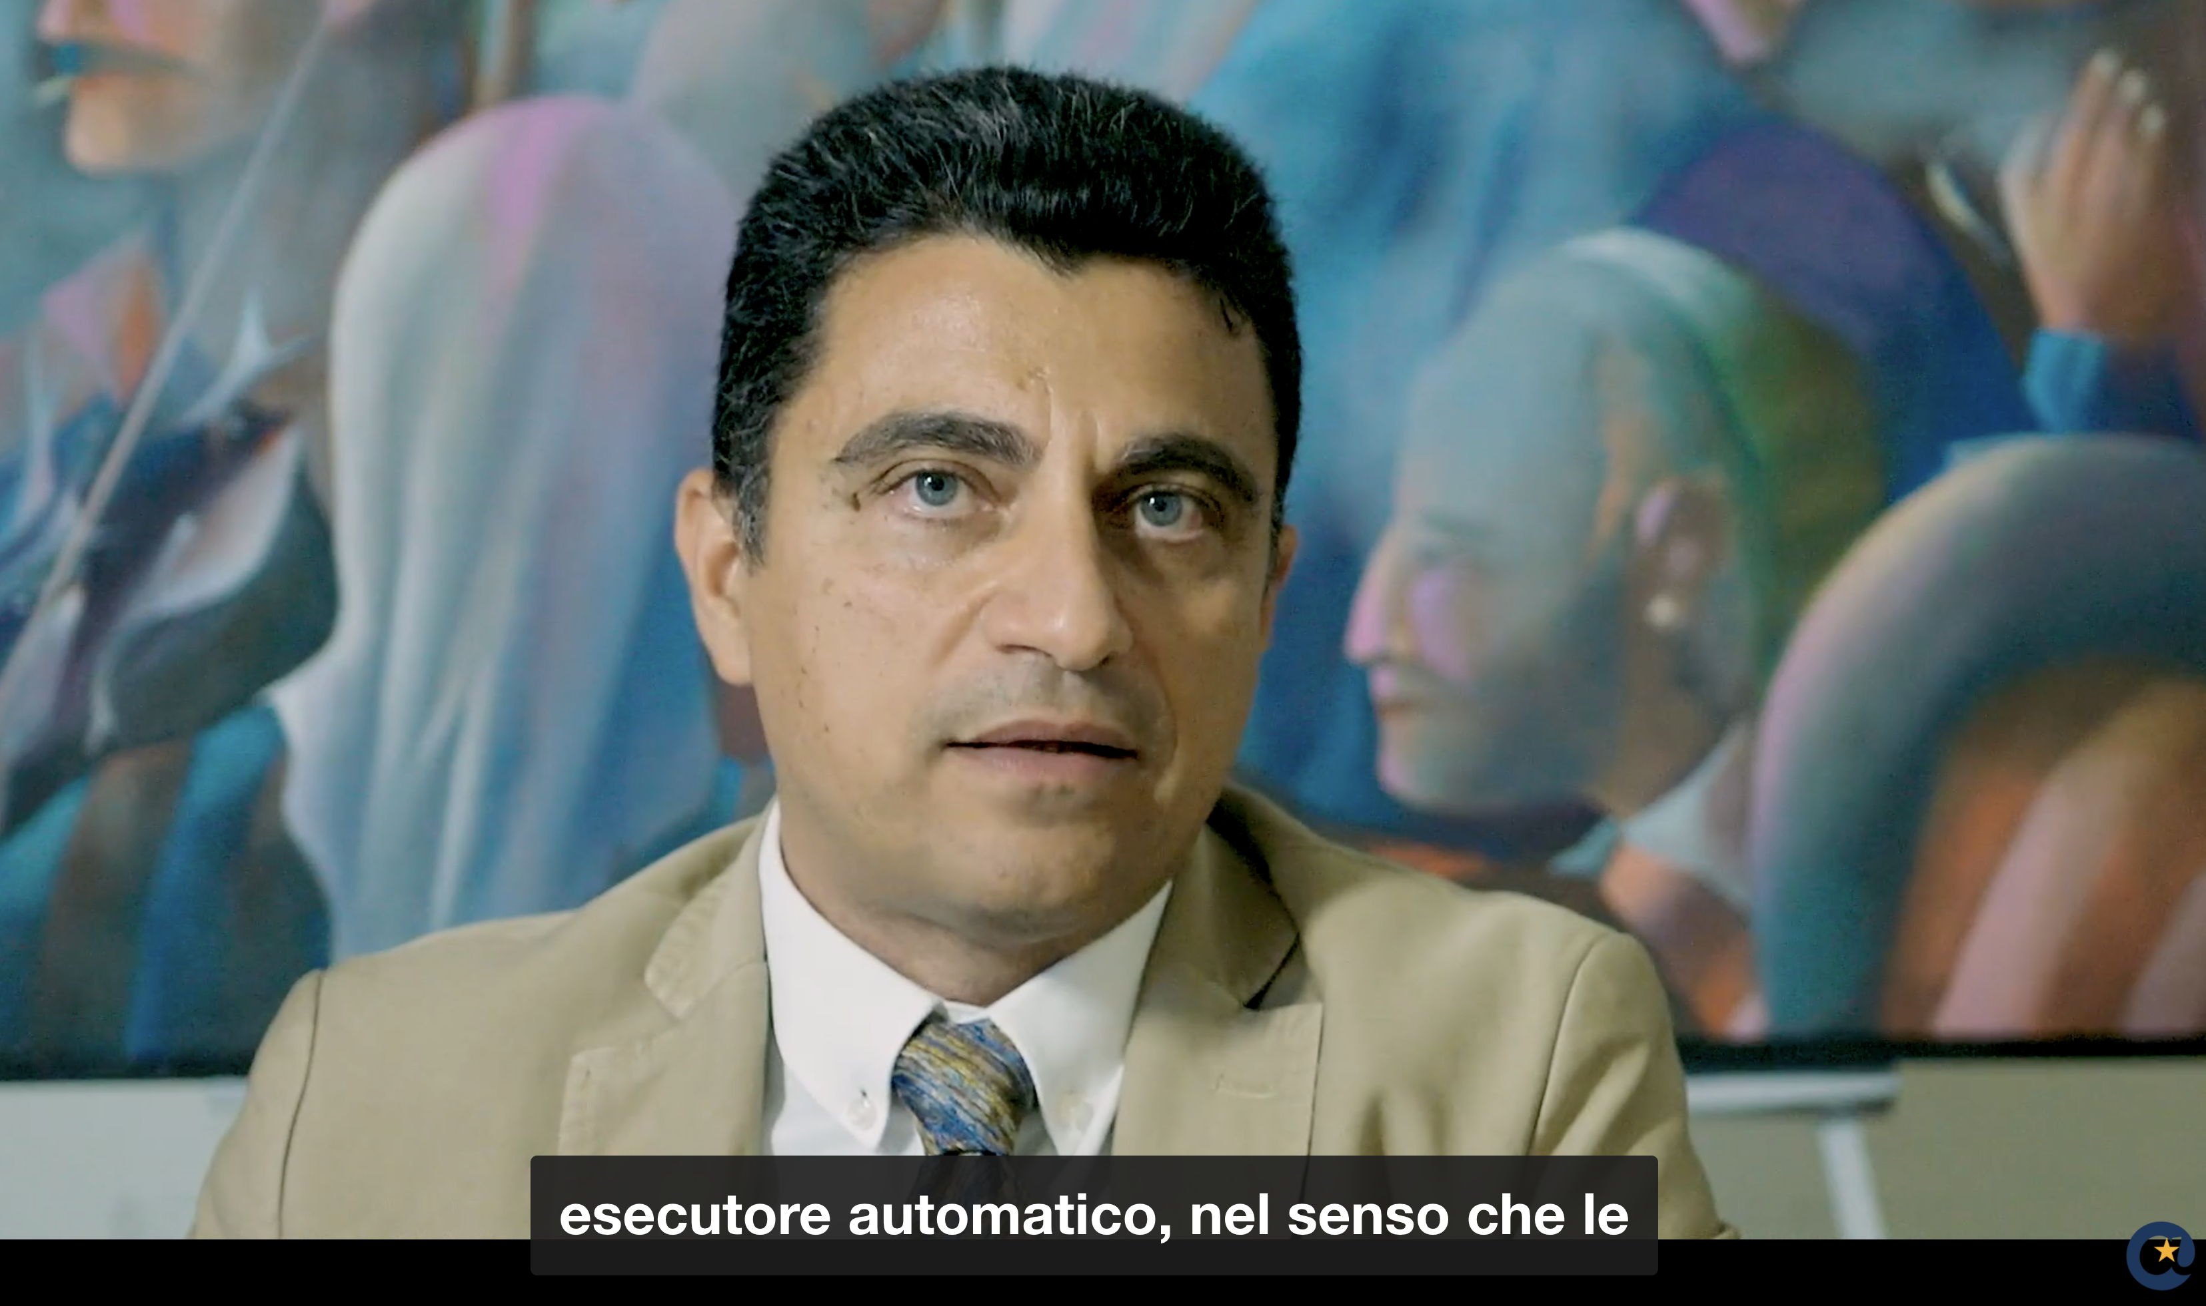
An example..
This is the first video lecture of Fundamentals of Computer Science made by professor Carlo Sansone on the Federica EU platform.
This video lecture takes about 6 minutes but…
…the time to create a video like this typically takes professors to the average 50-60 minutes.

Slide 4
How can we create a video lesson in a short time, following a written text?

Slide 5
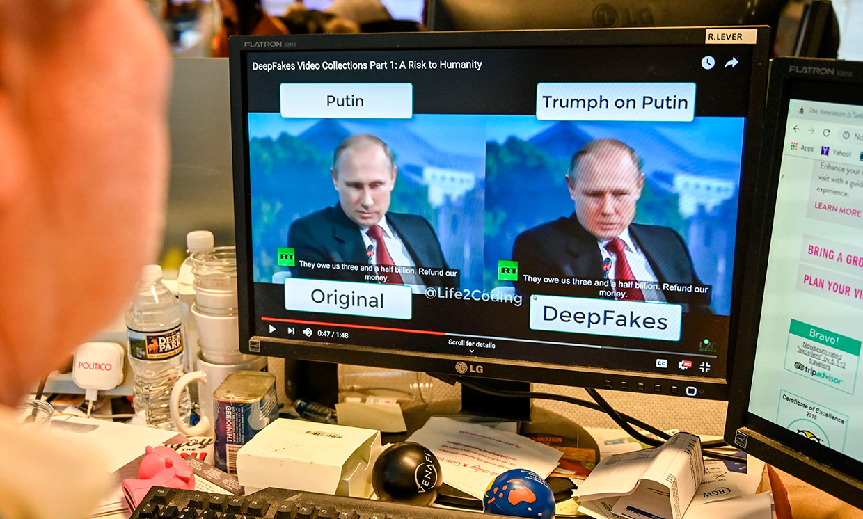
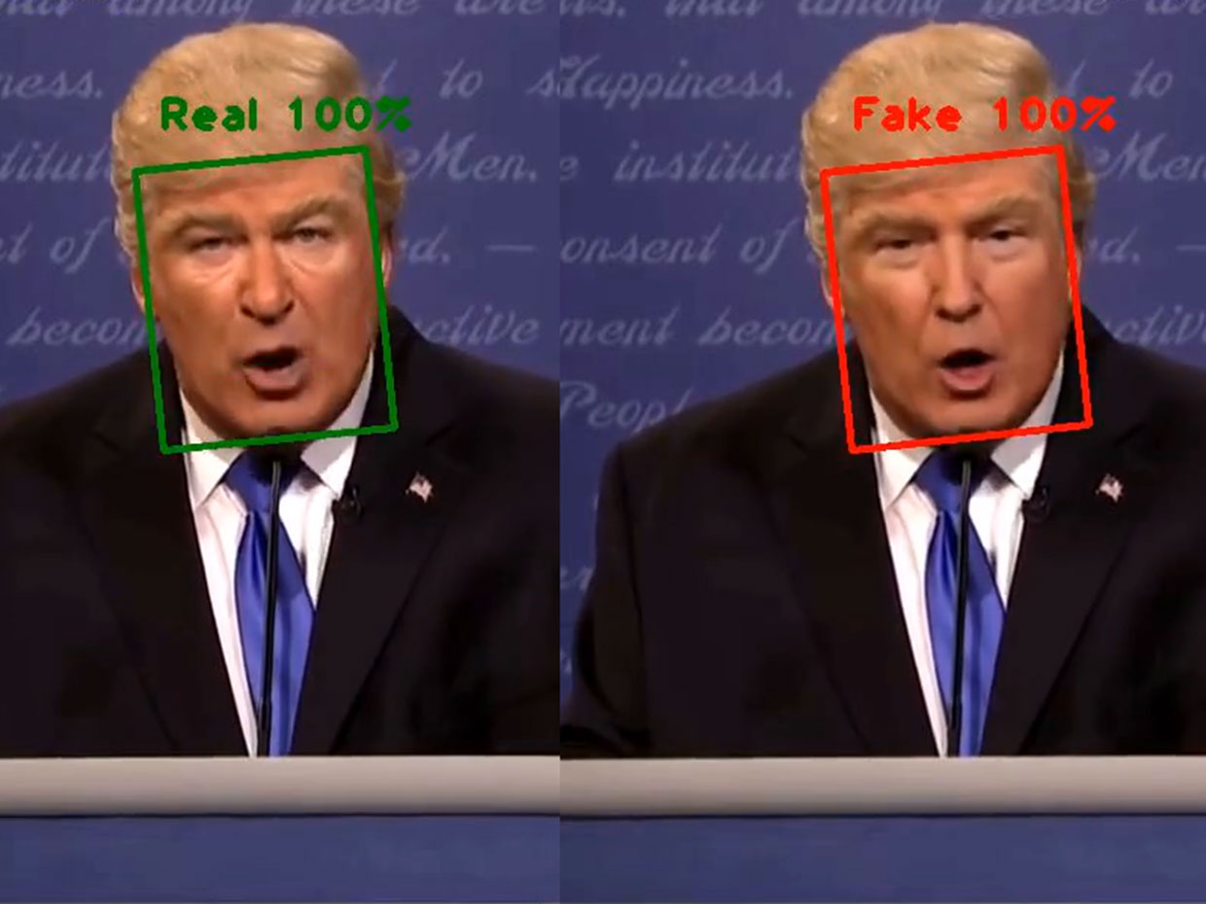
Using Deep fakes!
Deepfake technology can seamlessly stitch anyone in the world into a video or photo they never actually participated in.

Slide 6
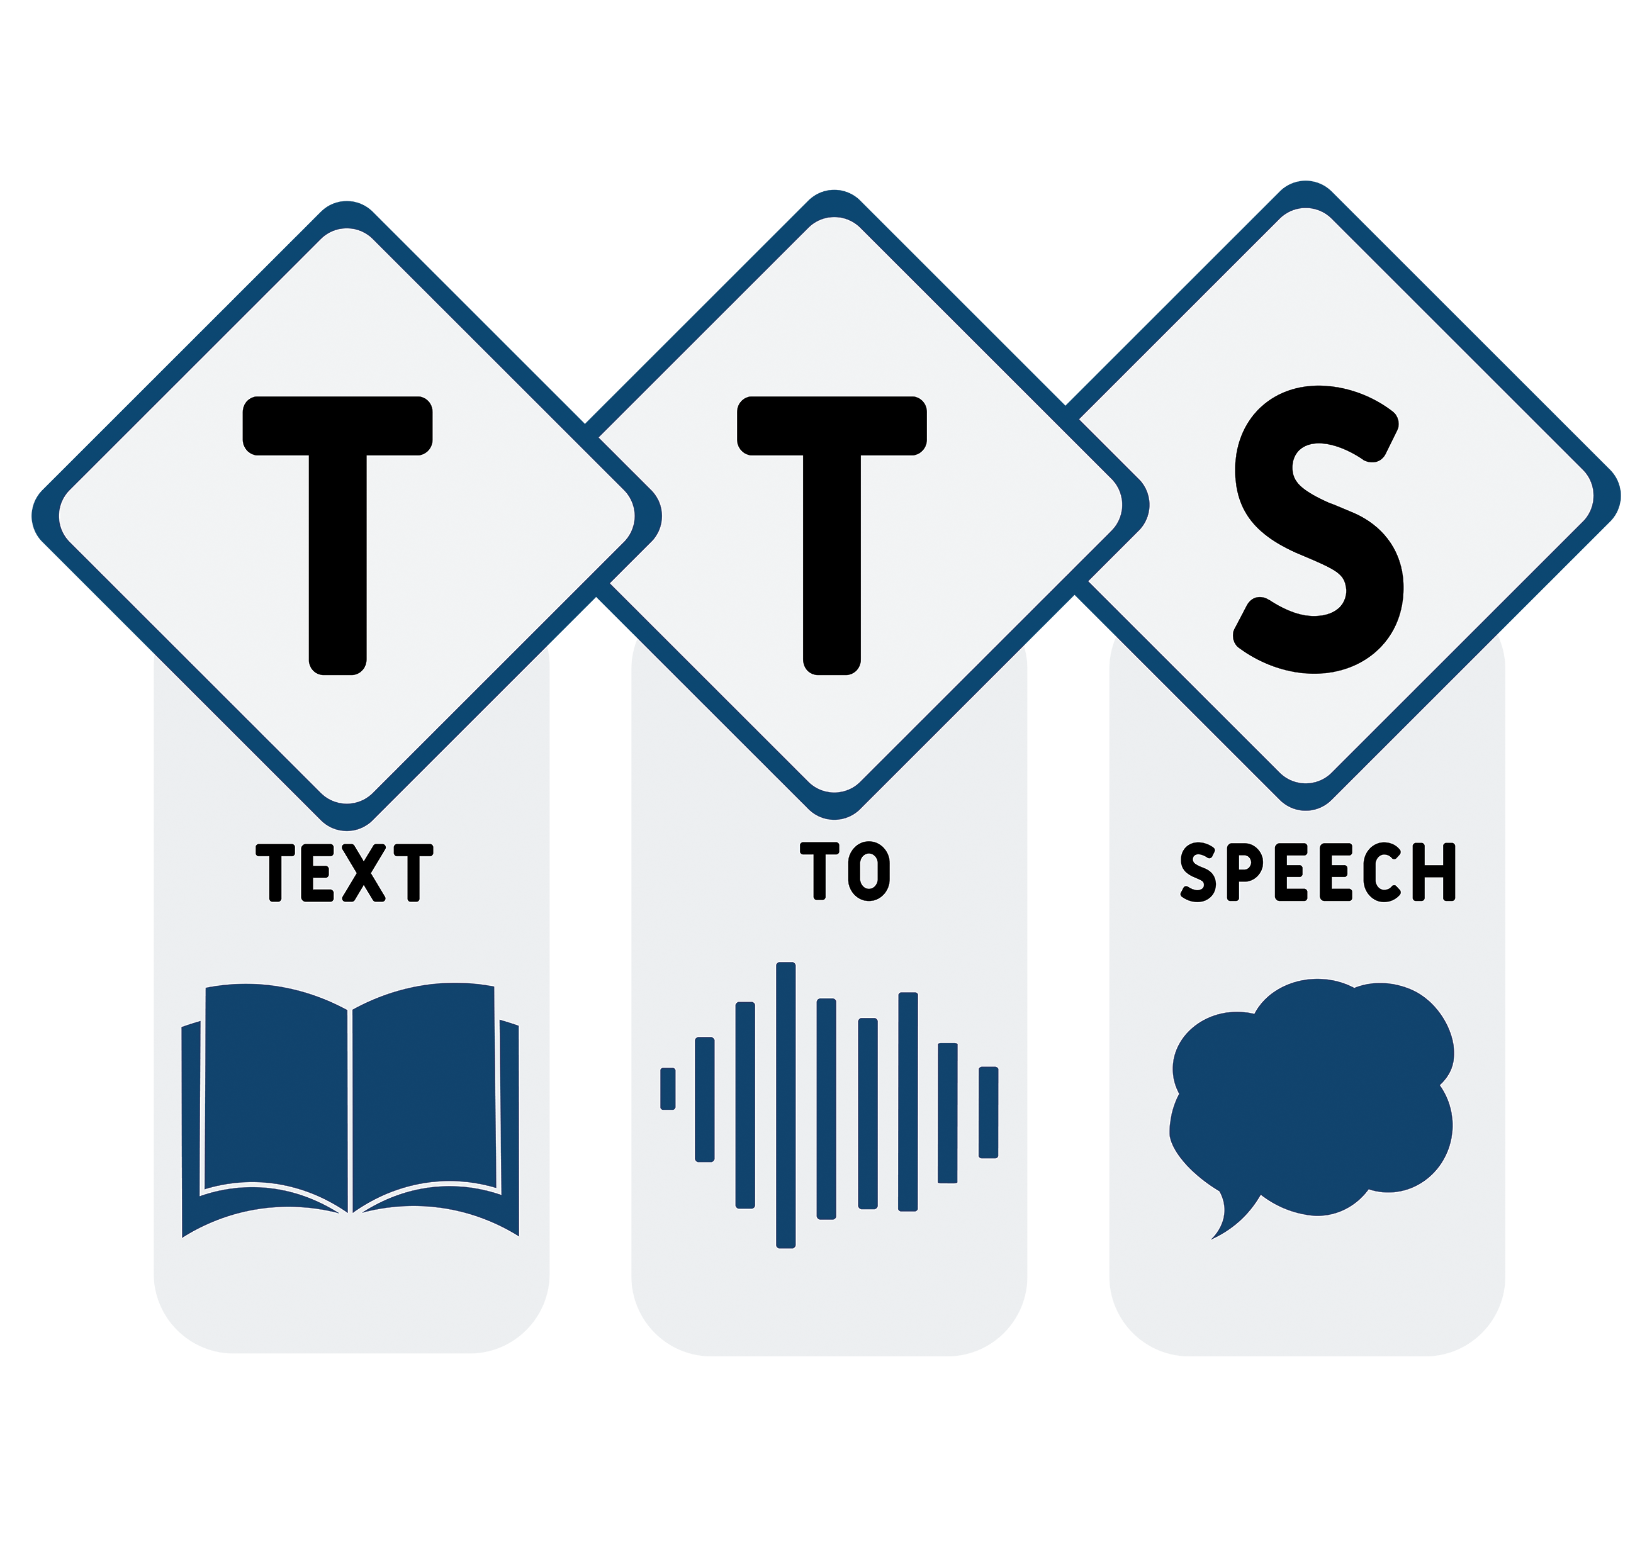
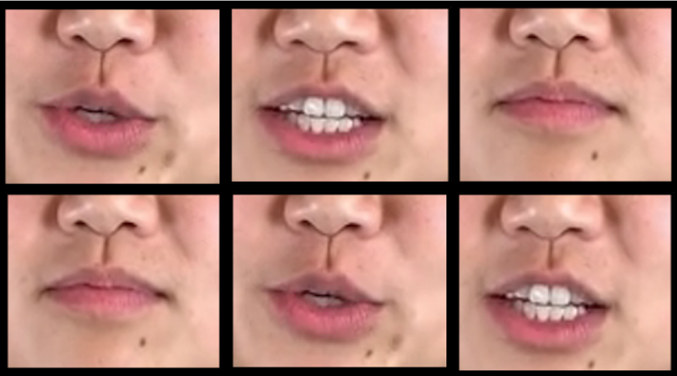
Our solution
Based on a maximum of one or two recordings of the author of the video, we have the data necessary for the generation of a deep fake lesson.
So, given this recordings, we will be able to assume the ability to generate these fake videos by also using techniques like:
Text to speech
Lip syncing

Slide 7
Github Libraries
Text to speech
Text to speech with custom voice, Beta https://cloud.google.com/text-to-speech/custom-voice/docs
Microsoft Azure https://speech.microsoft.com/portal
Nvidia Flowtron https://github.com/NVIDIA/flowtron
Lip syncing
Wav2Lip https://arxiv.org/pdf/2008.10010.pdf Colab Link

Slide 8
Github Libraries
Face Swapping
FSGan https://github.com/YuvalNirkin/fsgan
DeepFaceLab https://github.com/iperov/DeepFaceLab
Motion Co-segmentation https://github.com/AliaksandrSiarohin/motion-cosegmentation

Slide 9
Thank you
Ciro Sannino, 12/07/2021

